Slide 1
ITCC Roadmap: Approach, Areas
pptPlex Section Divider
The slides after this divider will be grouped into a section and given the label you type above. Feel free to move this slide to any position in the deck.

Slide 2
Project 3: ITCC Roadmap
Vladimir Alexiev, PhD, PMP Ontotext & ICT Cluster

Slide 3
Initial ITCC Projects
Small "seed" projects to kick off ITCC
Collaborative effort
Effort distribution (underlined: project lead)
Project | SU | Sirma | ICB | Total
1. State of the Art report | 22 | 10 | 3 | 35
2. eGov KPIs | 1 | 5 | 19 | 25
3. ITCC Roadmap | 2 | 10 | 3 | 15
(4. Initial website) |  | 5 |  | 5
Total | 25 | 30 | 25 | 80

Slide 4
Project 3: ITCC Roadmap
Purpose: develop ITCC Activity Roadmap
Total project effort: 15 person/days
Planning period: 1 year (2011). Actually 9m
Preparing project pipeline for a further year (2012)
Target number of projects: 8
Project started: 10 Feb

Slide 5
Planned Approach
Collaborative development of project ideas
Using wiki (Confluence)
Pipe/funnel methodology:
Determine areas of interest
Long list of project ideas (target 24)
Short list of project fiches (target 16)
Final list of approved projects (target 8)
During each stage, project ideas are elaborated progressively

Slide 6
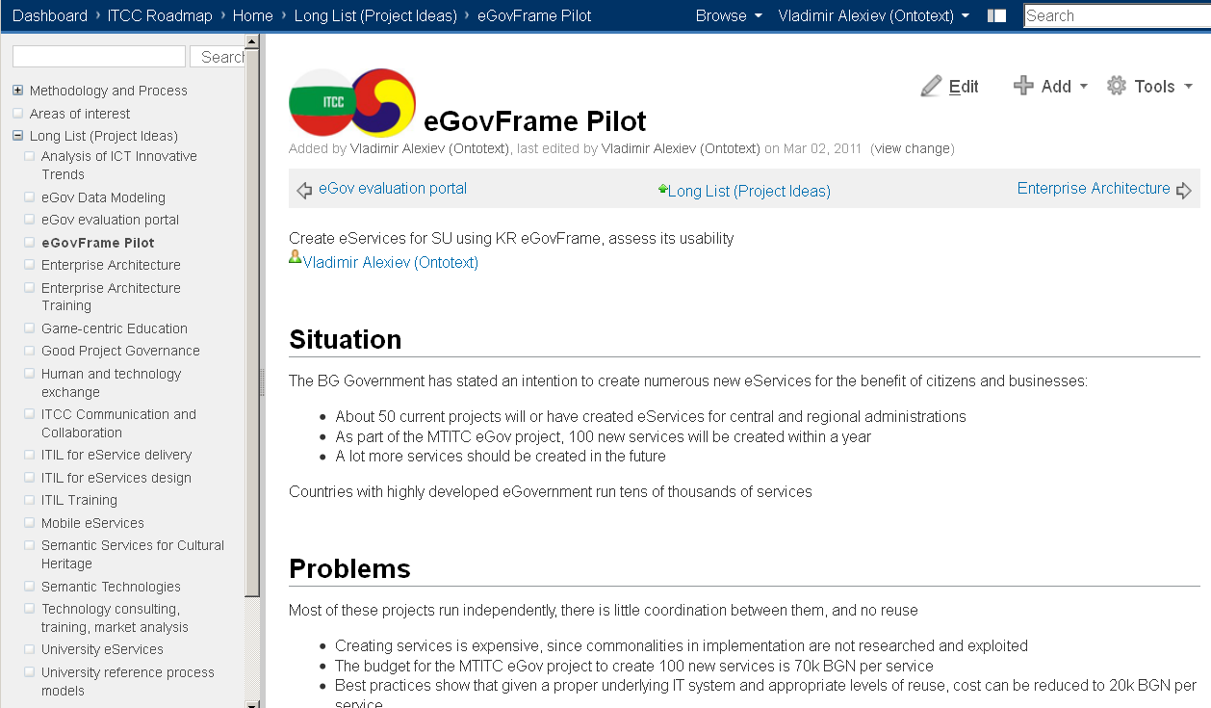
Collaboration using wiki
Website is built on the same platform and can be opened easily for collaboration by more experts!

Slide 7
Collaboration Process
Wiki enables broad participation and simultaneous gathering of data for many projects
Well-defined information templates are used to ensure comprehensive and consistent description
All information will be published in a final report using PDF export
Project 1 (eGov status overview) and Project 2 (development of KPI/criteria) provide important inputs for this project

Slide 8
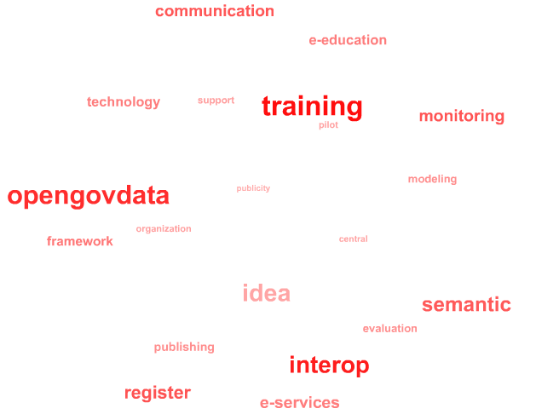
Areas of Interest
Areas of interest to ITCC are implemented as tags (Confluence Labels)
Mark each project idea with all applicable tags
This allows various reports (e.g. projects per tag) and analyses (e.g. most popular tags, "tag cumulus")
Government input was missing ☹
Although government interest is the most important criterion to ensure usability of ITCC results

Slide 9
List of Areas
Sampling of the areas
Will be supplemented from ideas and updated
support | Supporting areas
collaboration | collaboration on ITCC projects
communication | ITCC communications, intranet (confluence) and website
PR | public relations
organization | Organizational areas
evaluation | studies, criteria for selection and evaluation of eServices, projects, etc
legal | legal aspects of eGov: laws, bylaws, institutionalization
publicity | publicizing eGov use with citizens and businesses
pilot | Pilot project, proof of concept
technology | Technical areas
central | central services and registries
interop | IT application interoperability
register | register applications
framework | technological frameworks for developing eServices
modeling | modeling of information, data objects, business processes
security | IT security
generation | generation of software artifacts, including DB schemas, classes, screens
standardization | Analysis of e-service best practices and creation of reference models
innovation | Innovation areas
semantic | Semantic modeling, Semantic Web, Open Government Data
BPM | Business Process Management
BSC | Balanced scorecard strategic management
vertical | Vertical areas
e-Procurement | electronic procurement, incl. notices, application process, administrative procedures
e-Health | electronic health information, health care
e-Education | best practices for e-education in universities, schools
OpenGovData | Open Government Data

Slide 10
Project Ideas
pptPlex Section Divider
The slides after this divider will be grouped into a section and given the label you type above. Feel free to move this slide to any position in the deck.

Slide 11
Project Ideas
 | Project Idea | Description | Author(s)
1 | Analysis of ICT Innovative Trends | Analysis of current status and innovation development trends in the ICT field | Hristo Hristov (MTITC)
2 | eGov Data Modeling | Establish eGov data modeling practices and center of excellence | Vladimir Alexiev (Ontotext)
3 | eGov evaluation portal | Portal with information about eGov strategy, KPI values, project selection criteria, performance appraisal | Veselin Stoyanov (ICB)
4 | eGovFrame Pilot | Create eServices for SU using KR eGovFrame, assess its usability | Vladimir Alexiev (Ontotext)
5 | Enterprise Architecture Training | Training for government specialists in Enterprise Architecture Management | Veselin Stoyanov (ICB)
6 | Enterprise Architecture | Enterprise Architecture refers to the integrated modeling of objectives, processes, organizational structure, applications, IT infrastructure, data and documents in the organization. | Veselin Stoyanov (ICB)
7 | Game-centric Education | Game-centric Technology-Enhanced Education (GAMEDU) | Boyan Bonchev (SU FMI)
8 | Good Project Governance | Improving project governance and public accountability | Vladimir Alexiev (Ontotext)
9 | Human and technology exchange | Foster exchange, cooperation, researcher mobility | Bojil Dobrev (SU R&D)
10 | ITCC Communication and Collaboration | Establish and maintain ITCC Communication and Collaboration infrastructure | Vladimir Alexiev (Ontotext)
11 | ITIL for eService delivery | Use ITIL reference processes to improve the delivery and maintenance of eGov services | Veselin Stoyanov (ICB)
12 | ITIL for eServices design | Use ITIL reference processes to improve design processes for eServices | Veselin Stoyanov (ICB)
13 | ITIL Training | ITIL training for government employees for delivery and support of eServices | Veselin Stoyanov (ICB)
14 | Mobile eServices | Pilot project for creating mobile access to eServices | Dimitar Birov (SU FMI), Vladimir Alexiev (Ontotext)
15 | Semantic Services for Cultural Heritage | Community-Oriented Map-Based Portal for Cultural Heritage with Semantic Services (COMPORHESS) | Boyan Bonchev (SU FMI), Dimitar Birov (SU FMI)
16 | Semantic Technologies | Joint Korea-Bulgaria study of Semantic Technologies for building advanced eGov Infrastructure | Jaehong Yoon (ITCC)
17 | Technology consulting, training, market analysis | Technical consulting and support, eGov training, eGov market analysis | Bojil Dobrev (SU R&D)
18 | University eServices | eServices as the Road to Administrative Reform at Universities | Denitsa Hinkova, Prof Tanev (SU)
19 | University reference process models | Creation of reference process models for Universities | Veselin Stoyanov (ICB)

Slide 12
Project Idea Grouping
Technology Projects
eGovFrame Pilot
Mobile eServices
University eServices
University reference process models
eGov Design
eGov Data Modeling
Enterprise Architecture Training
Enterprise Architecture
Public Governance
eGov evaluation portal
Good Project Governance
IT Governance
ITIL for eService delivery
ITIL for eServices design
ITIL Training
Semantic Technologies, Innovation
Semantic Technologies
Semantic Services for Cultural Heritage
Consulting Activities
Analysis of ICT Innovative Trends
Technology consulting, training, market analysis
Supporting Activities
Human and technology exchange
ITCC Communication and Collaboration
Miscellaneous
Game-centric Education

Slide 13
Idea Description Format
Situation
What is the current situation in BG eGov relation to the idea's subject
Problems
What are the perceived problems
Needs
What needs and requirements the project should satisfy
Possible Approach
What could be possible project tasks and deliverables

Slide 14
Sample Project Idea
eGovFrame Pilot
Create eServices for SU using KR eGovFrame, assess its usability
Situation
The BG Government has stated an intention to create numerous new eServices for the benefit of citizens and businesses:
About 50 current projects will or have created eServices for central and regional administrations
As part of the MTITC eGov project, 100 new services will be created within a year
A lot more services should be created in the future
Countries with highly developed eGovernment run tens of thousands of services

Slide 15
Sample Project Idea (2)
Problems
Most of these projects run independently, there is little coordination between them, and no reuse
Creating services is expensive, since commonalities in implementation are not researched and exploited
The budget for the MTITC eGov project to create 100 new services is 70k BGN per service
Best practices show that given a proper underlying IT system and appropriate levels of reuse, cost can be reduced to 20k BGN per service
When services address related business functions (e.g. Civil registration in two regions) independently, this creates further problems:
Usability: it is harder for the citizen to use the services since he needs to learn new paradigms every time
Interoperability: it is harder for the two administrations to exchange data
Open Source is not widely used in Bulgaria

Slide 16
Sample Project Idea (3)
Needs
There is need to create or adopt an eServices Technology Framework (ETF), which facilitates the creation of eServices.
Commonality of implementation will:
Set a standard for user interfaces
Improve usability by allowing ETF improvements to propagate to all eServices created with ETF
Facilitate real interoperability
Desired goals:
creating eServices should become an easy byproduct of creating any government IT system. The ETF should not be a hurdle for developers to overcome, but a delight to work with
the ETF should be open source, so it can be used and extended by government contractors collaboratively

Slide 17
Sample Project Idea (4)
Desired ETF Functionalities
Data modeling
Data persistence
Screen generation, based on an enriched data model, including GUI hints (e.g. size, position and widget used for each field)
Automatic online and offline data validation, based on XML Schema types and cross-field validation rules in the data model
Context-based error reporting (error is shown in a tooltip over the offending field)
Workflow and BPM functionality
Printing (PDF generation) of eService-related documents that are legally binding (Austrian best practice) and have typographic quality
Unified access to eServices through the eGov Portal, facilitating automatic service metering (usage metrics) and statistics
Working with eSignatures
Storing of Draft versions of documents
Document exchange through Unified System for Electronic Document Exchange (USEDE)
Etc, etc

Slide 18
Sample Project Idea (5)
Possible Approach
Research best practices, both technical (e.g. use of screen generation) and organizational (project execution, reuse):
BG agencies that have created successful and highly used services (e.g. National Revenue Agency, Bulgarian Customs Agency, National Statistical Institute)
Other governments
Run a pilot project to adopt the KR eGovFrame, which NIA has promised to donate to BG
Implement a couple of eServices for Sofia University (SU) using eGovFrame
Create an eGovFrame Assessment Report: ease of use, understandability, universality, cost of creating services, required additions to comply with BG eGov law
Future steps if the pilot is successful:
Adapt eGovFrame to BG legislation and extend it with BG-specific functions
Establish a center of excellence to facilitate the use of ETF, support developers, maintain and extend it

Slide 19
Selected Projects (1)
pptPlex Section Divider
The slides after this divider will be grouped into a section and given the label you type above. Feel free to move this slide to any position in the deck.

Slide 20
Actual Approach
Due to time pressure, we skipped the short list
Project timeline:
Start: Feb 10
Project ideas collected until: Mar 1, discussed: Mar 2
Ideas combined and selected: Mar 8
Roadmap to be approved by Steering Committee: Mar 11 & 12
Actual Numbers:
Ideas submitted: 19
Ideas combined and selected: 9

Slide 21
Selected Projects
1. Joint Projects
1.1 Semantic Web for eGov
1.2 eService Technology Framework adopting KR eGovFrame
1.3 eGov Best Practices research & recommendation
1.4 Analysis of ICT innovation trends
2. Technology and HR Exchange
2.1 Korea-Bulgaria ICT Forum
2.2 Students/Lecturers Exchange Programme
2.3 Provision of Korean Digital Content
3. Support Actions (Internal Management)
3.1 ITCC Communication and Collaboration, Web Site
3.2 Financial Management
(Note: I made up the numbering)

Slide 22
1.1 Semantic Web for eGov
Pilot application of Semantic Technologies for advanced eGov infrastructure
Situation
Innovative emerging area: Web 3.0; led by W3C
KR & BG are leading countries in their regions
Opportunities
Highest potential for high-tech collaboration
Commercialize next generation technology
Better services for citizens
Possible pilot application areas
Open Government Data (eg Comparative census of EU data initiatives, World Map of Open Gov Data Initiatives)
Semantic [Meta-] Search
Bulgarian Cultural Heritage
Mobile and Social eServices

Slide 23
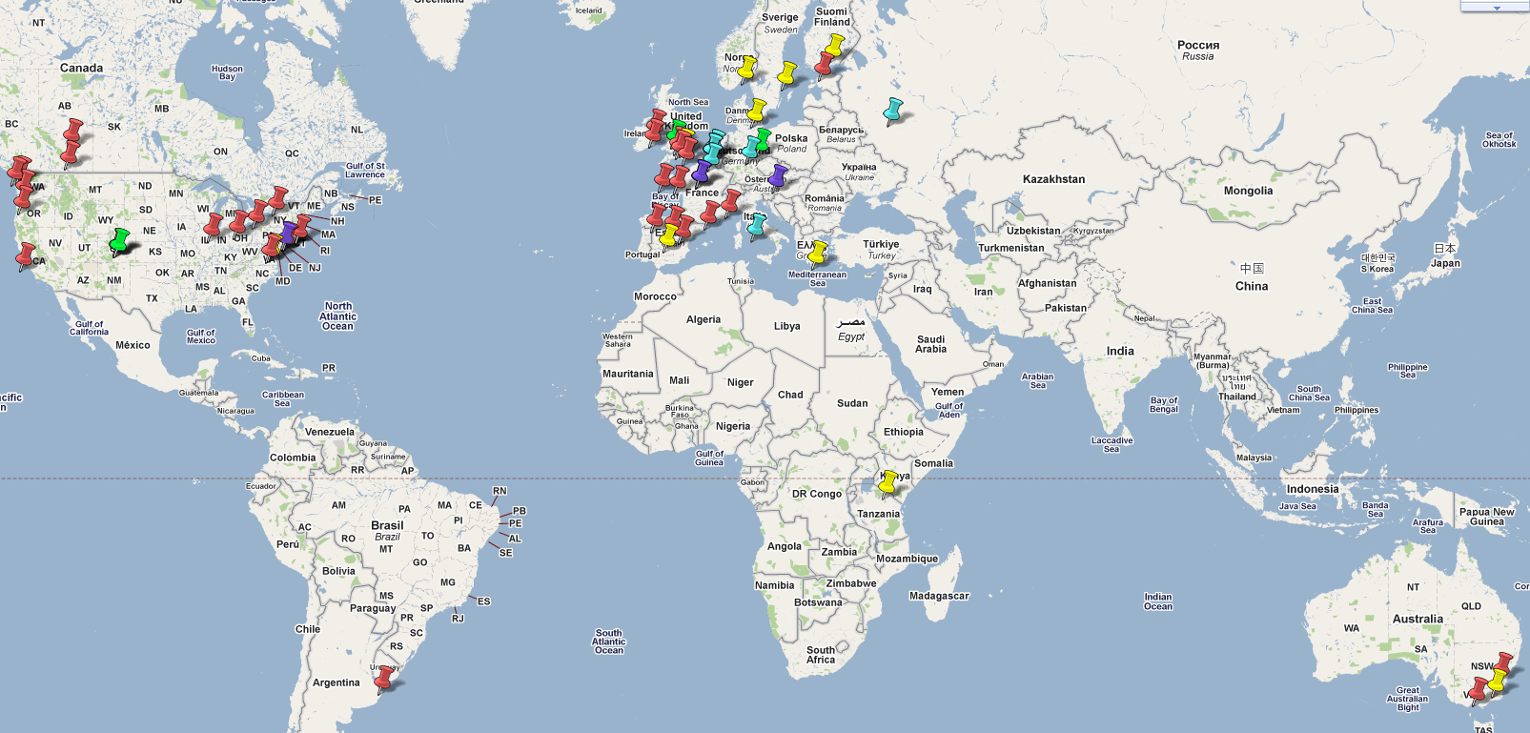
Map of Open Gov Data Initiatives
Color | Legend
RED | local or regional governmental authorities
GREEN | local or regional private initiatives
YELLOW | nationwide governmental authorities
BLUE | nationwide private initiatives

Slide 24
1.2 ETF adopting KR eGovFrame
Pilot an open source eService Technology Framework (ETF) adopting KR eGovFrame
Situation
Many eServices are in development in BG
Projects run independently, little coordination, no reuse
E.g. each region develops its own civil document services, although the database (ЕСГРАОН) is centralized
Benefits
Government: economies, reuse, vendor independence, easier interoperability (real, not just legislated)
Users: better usability through standard UI & functions
Developers : open standard system, collaboration, SME
Possible pilot application areas
Municipal eServices
University reference process model & eServices

Slide 25
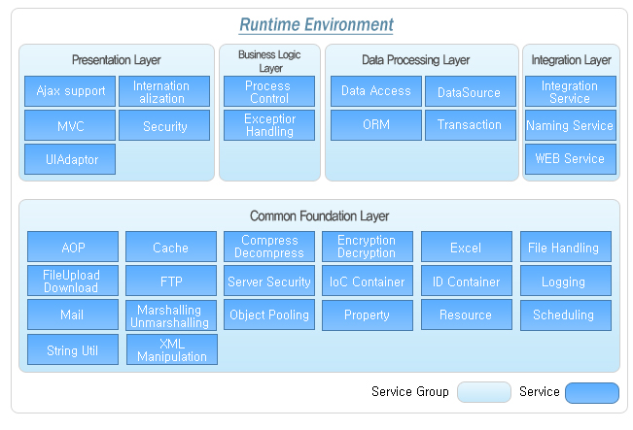
eGovFrame Runtime Env
Mapping to Open Source frameworks: http://www.egovframe.go.kr/EgovEnvRun_Eng.jsp?menu=1&submenu=3&leftsub=1

Slide 26
eGovFrame Development Env
Based on open source, Java, Eclipse. Includes:
Development Environment Main
introductory contents and links to the development tools
Methodology and Template
various documentations for developing eGovFrame applications
Implementation Toolset
IDE
Editor (SourceCode, UML, ERD, DBIO, WebFlow)
Automatic Code Generation and Inspection
Debug setup (Local, Remote)
Test Toolset
write test code, automate testing
JUnit Test Framework, Eclipse Plugin, Ant Task, Maven2 Plugin, Excel reporting of test results
Deployment Toolset
FTP transmission of web app archive (WAR) to Application Server
WAR deployment, start/stop
Issue Management

Slide 27
eGovFrame Common Services
Includes 181 common shared services
http://www.egovframe.go.kr/Egovcmm_Eng.jsp?menu=2&submenu=3
User Authentication/Directory Service (4)
User Authentication (2)
Directory Service (LDAP) (2)
Security (8)
Real Name Authentication (2)
Role/Rights Management (5)
Encryption/Decryption (1)
Statistics/Reporting (5)
Collaboration (22)
Board (10)
Community (4)
SMS (1)
Schedule Management(4)
Email (1)
Address Book/Name Card (2)
User Support (36)
User Management (3)
Personalization (1)
Provision Management (3)
Online Help (6)
Online Participation (9)
Information Service/Notification (14)
System Management (20)
Common Code Management (7)
Log Management (6)
Menu Management (3)
Program Management (1)
Calendar (3)
System/Service Integration (4)
Utility Technology (74)
Message Handling (4)
Print/Output (3)
Cookie/Session (2)
Interface/Screen (2)
Web Editor (1)
Format/Calculation/Conversion (23)
System (39)

Slide 28
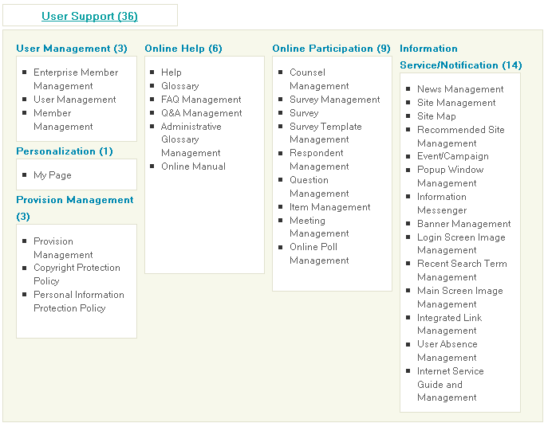
eGovFrame Service Group

Slide 29
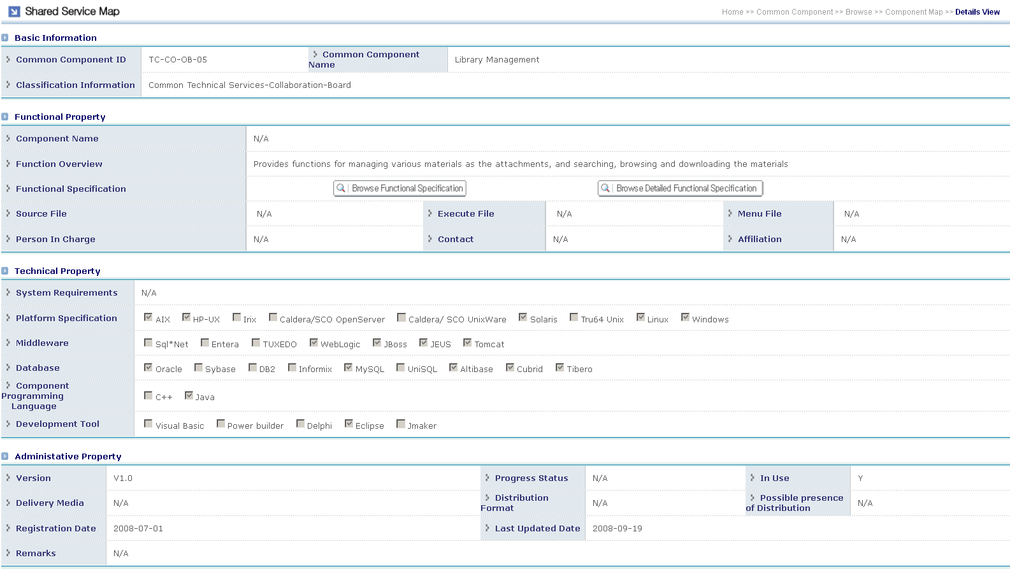
eGovFrame Component Passport

Slide 30
Selected Projects (2), Implementation
pptPlex Section Divider
The slides after this divider will be grouped into a section and given the label you type above. Feel free to move this slide to any position in the deck.

Slide 31
1.3 eGov Best Practices
Situation
BG spent significant amount of money for eGov projects
Few useful eServices, skepticism in society
Problems
No clear and measurable goals
Lack of “Rule of Procedure” for good project governance
Wasted effort
Approach
Research KR and world best practices
Gap analysis between best practices & BG practices
Build national consensus, make recommendations
Possible project areas
Data Modeling, Business Process Modeling
Enterprise Arhitecture, ITIL
Public accountability: eGov Evaluation portal, Project Register

Slide 32
1.4 Analysis of ICT innovation
Situation
Era of global economic crisis
Lack of competitiveness of BG industries, SME
ICT is the exception to some extent
Needs
Scientific research to assess the approach
Redirection of BG industry structure
Possible Approach
Organize expert group for elaborating methodologies
Assess best practices in countries that overcame the crisis
Choose BG-suitable products, services & policy

Slide 33
2.1 Korea-Bulgaria ICT Forum
Organize two workshops
Spring: 11 March 2011
Place: Sofia, Bulgaria
KR-BG eGov experts workshop
Participants: government officials, industry, universities
Autumn: October 2011
Place: Korea or Bulgaria
Subject: TBD
Participants: TBD

Slide 34
2.2 Students/Lecturers Exchange
Situation
Some Masters courses in eGov, eLearning etc
Teaching is based on literature sources
BG local lecturers and local experiences
Needs
Enrich delivery of program with advanced approaches
Leading countries experiences
Possible Approach
Collaboration with appropriate KR University (Institute)
Invite BG Master students to KR
Exchange lecturers between the two countries

Slide 35
2.3 Korean Digital Content
Situation
KR donated Internet facilities to BG in 2004
BG runs Internet Plaza with the facilities in Sofia
PC, Beam projector, Screen, A/V systems
Needs
Enhance usage of Internet Plaza
Introduce KR digital content (movies, documentaries…)
Provide cultural service to local people in Sofia
Possible Approach
Play KR digital content at the Internet Plaza
Internet Plaza provides the space and projector
ITCC provides the digital content

Slide 36
3.1 ITCC Comm & Collaboration
Problems
Currently ITCC does not communicate effectively. Email is used for all communication. Important ideas, documents and links are lost and forgotten in emails
Collaboration is sub-optimal. No shared workspace, projects do not share documents, no tracking of tasks, carry over and followup.
ITCC's public communication is rudimentary
Needs
Efficient communication channel with the Government
Collaboration with the IT associations (BAIT, BASSCOM, ICT Cluster)
Effective communication and collaboration system (wiki)
Establish wiki use templates, best practices, macros, etc
Prepare wiki training and HowTo pages. Train everyone to use the wiki effectively and pervasively
Perform "Wiki Gardening": spend time attending to the quality, flow, and overall polish of content; help people use the wiki through hands-on teaching; promulgate good Wiki Patterns
Public website
Website should be quite open since ITCC works for the public interest. Possible self-registration of eGov experts can, extensive discussion forums. "Natural extension" of the wiki
Social presence, e.g. Facebook eBulgaria2020 group, Twitter, Slideshare, etc
PR and media presence. Collaborate with eGov-related media and conferences

Slide 37
3.2 Financial Management
Needs (internal management)
Preparation of tender documents
Execution of public procurement procedures
Negotiation and Contracting
Contract execution and monitoring
Accountability to donors and Steering Committee

Slide 38
Project Implementation
Proposed timeline:
Mar-Apr: prepare project details (concept, work packages, deliverables, work breakdown)
Apr-May: prepare tender documents
Apr-May: find KR project partners
May: partner meeting in KR (travel exp covered)
May: public procurement procedure
Jun: projects start
Only 7m for project execution
Can we speedup timeline?
Successful projects can be extended in second year

